Slide 1

Security
Computer System Engineering, Fall 2017. (IPADS, SJTU)
Minimize TCB
Yubin Xia

Slide 2
Trust and Security

Slide 3
Reflections on Trusting Trust
Author Ken Thompson
Turing Award Lecture
422 citations (Google Scholar)

Slide 4
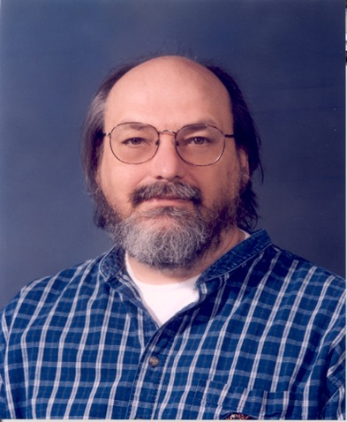
Ken Thompson (1)
Master's Degree from University of California, Berkeley, USA
Worked on the Multics operating system
Creater of the UNIX operating system together with Dennis Ritchie

Slide 5

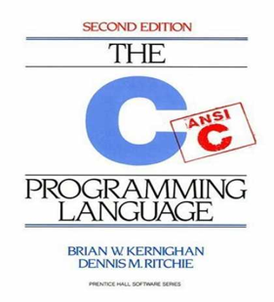
Ken Thompson (2)
Creater of the systems programming language B
a predecessor to the C language
1983 – Joint Turing Award with Dennis Ritchie for their work on UNIX
1999 – National Medal of Technology awarded by Bill Clinton

Slide 6
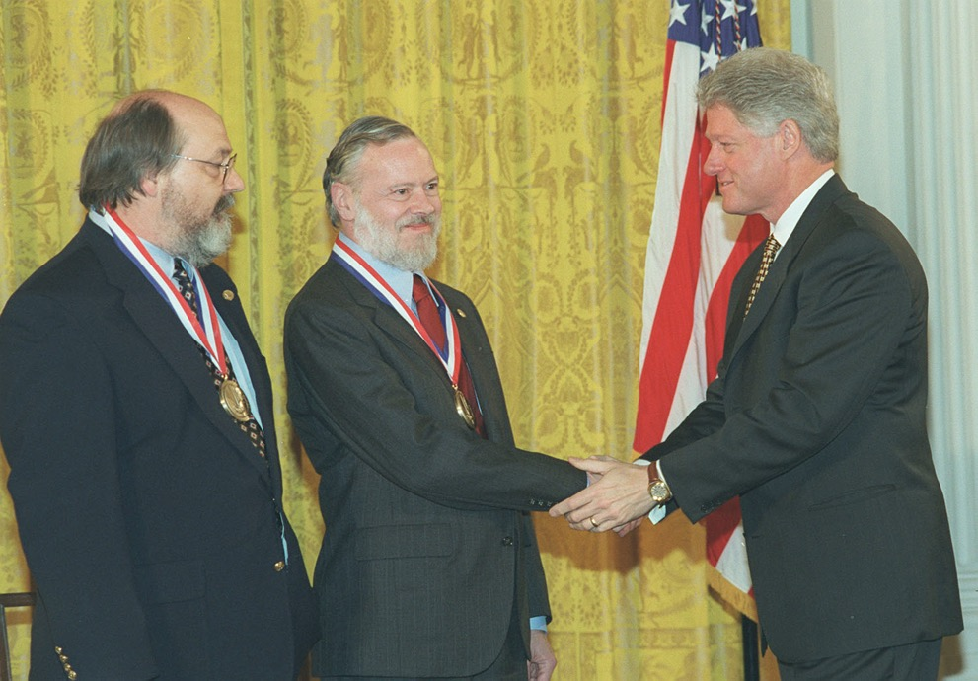
Presentation of the National Medal of Technology

Slide 7
"I am a programmer. On my 1040 form*, that is what I put down as my occupation. As a programmer, I write programs. "
"I would like to present to you the cutest program I ever wrote."
* 1040 form = U.S. Individual Income Tax Return

Slide 8
Trusting Trust: Some Observations
Stage I:
A program can, when executed, output its own source-code
Stage II:
A compiler can learn the meaning of a symbol
Stage III:
A compiler may (deliberately) output incorrect machine code

Slide 9
Stage I: A self-reproducing program
In the C language:
main() { char *s="main() { char *s=%c%s%c;
printf(s,34,s,34); }"; printf(s,34,s,34); }
In LISP:
((lambda (x) (list x (list 'quote x)))
(quote (lambda (x) (list x (list 'quote x)))))

Slide 10
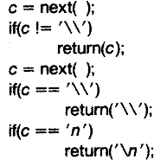
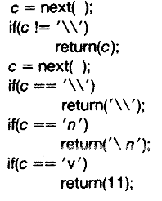
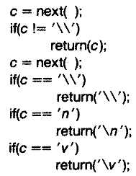
Stage II: A learning compiler
Somewhere inside a C compiler ...
1) We wish to add the vertical tab (\v) symbol
2) We return its ascii value (11) if the symbol is \v
3) We recompile our compiler, and we can now change our implementation to simply return \v

Slide 11
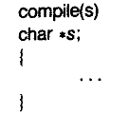
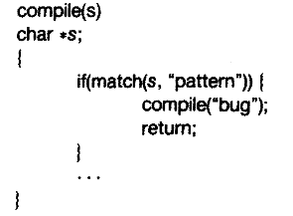
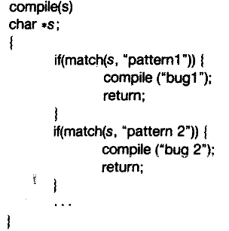
Stage III: A bugged compiler

Slide 12

What happens?
source-code of bugged compiler
source-code of innocent compiler
source-code of /bin/login program
compiler
bugged compiler
bugged compiler

Slide 13
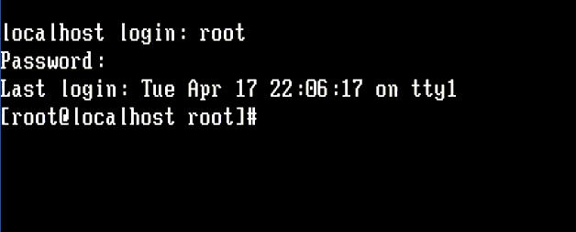


Slide 14

Moral
"The moral is obvious. You can't trust code that you did not totally create yourself. (Especially code from companies that employ people like me.)"
Today, Ken Thompson works as a distinguished engineer for Google

Slide 15
Is this a real problem?
Yes, it happened to a Delphi compiler in 2009!
Win32/Induc-A
Another example:
XCodeGhost on iOS. In 2015, China
https://zh.wikipedia.org/wiki/XcodeGhost%E9%A3%8E%E6%B3%A2

Slide 16
Moral (continued)
"No amount of source-level verification or scrutiny will protect you from using untrusted code."

Slide 17
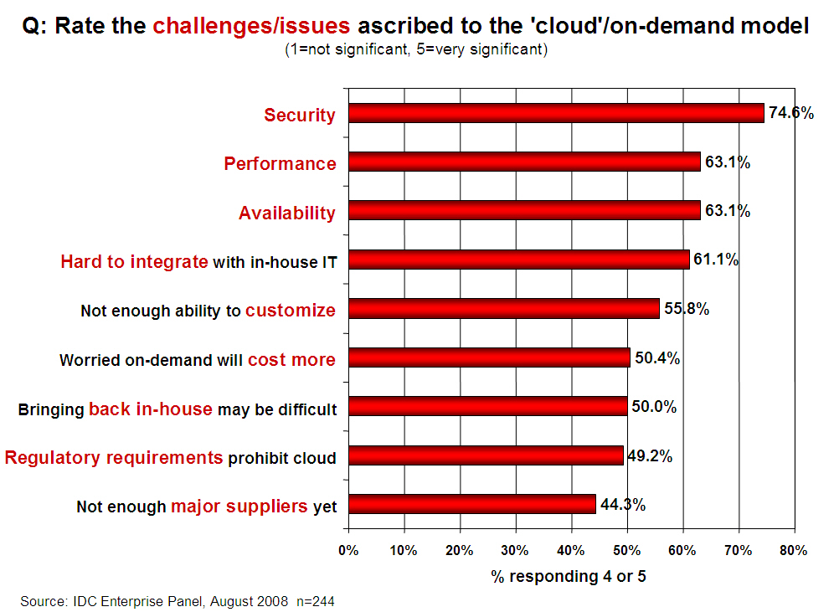
Challenges Ascribed to the Cloud [IDC 2008]

Slide 18
7 Threats of Cloud Security [Gartner 08]
Privileged operator access
Regulatory compliance
Data location
Data segregation
Recovery
Investigative support
Long-term viability

Slide 19
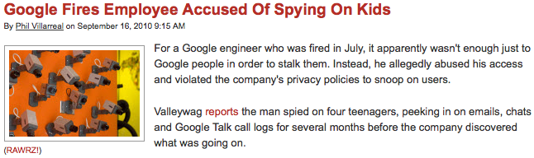
Security Challenges: Inside Attacks
..., peeking in on emails, chats and Google Talk call logs for several months …

Slide 20
Minimize TCB

Slide 21
Principle of Least Privilege
Every program and every privileged user of the system should operate using the least amount of privilege necessary to complete the job.
- Jerome Saltzer

Slide 22
TCB: Trusted Computing Base
TCB is the parts that are trusted
Process never trust another process, but trusts all its threads
OS never trust a process, but trusts hardware
VMM never trust a VM, but trust hardware
Which parts do you trust in your laptop? Your phone?
TCB is the only metric of security
Bug is inevitable

Slide 23

Root of Trust
There must be some thing to trust
Other trusts are based on the root of trust
Aka., bootstrap
Root of trust can be software or hardware
Software: BIOS, VMM, kernel loader, kernel, etc.
Hardware: TPM, secure processor, etc.
Cogito ergo sum

Slide 24
TPM: Trusted Platform Module
The TPM is the Root of Trust for Reporting
Think: smartcard-like security capability embedded into the platform
The TPM is uniquely bound to a single platform
TPM functions and storage are isolated from all other components of the platform (e.g., the CPU)

Slide 25
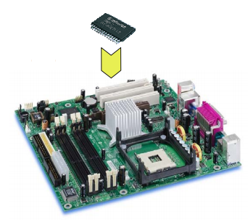
TPM: Trusted Platform Module
TPM on mainboard

Slide 26
TPM Functions
Sealed storage for private key
Physically safe (for most of the time)
Sign with the private key
For remote attestation
Measure with hash chain
For local trust-chain

Slide 27
No Trust to OS

Slide 28
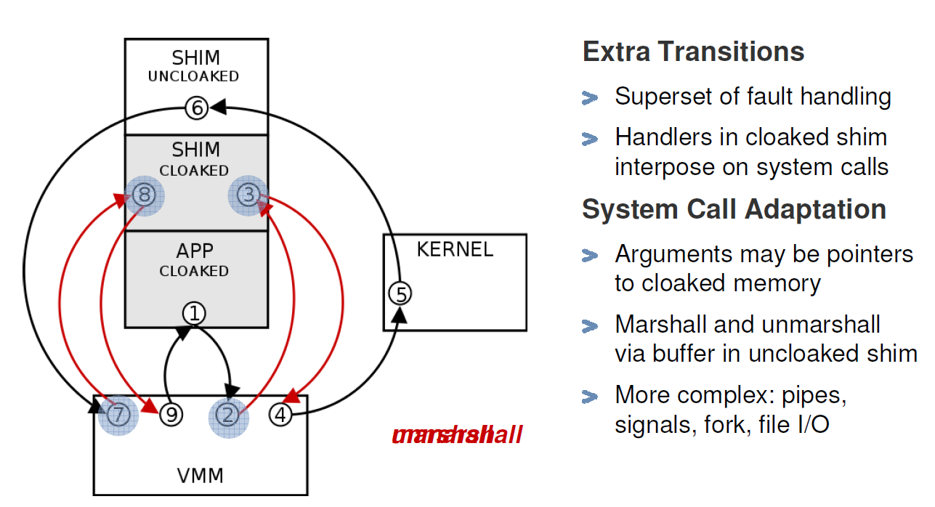
Overshadow: Untrusted OS
Marshall
Unmarshall

Slide 29
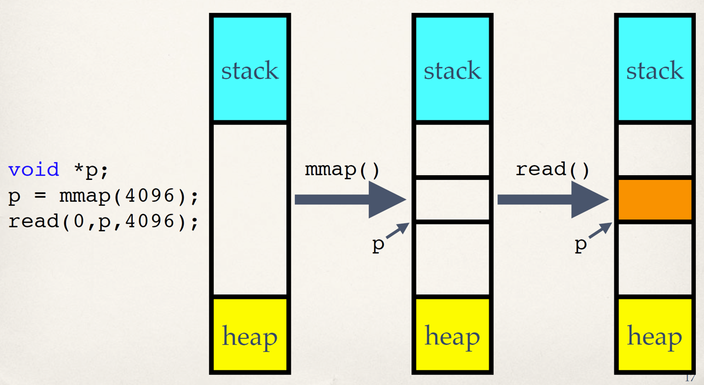
Iago Attack: mmap() (Normal Behavior)

Slide 30
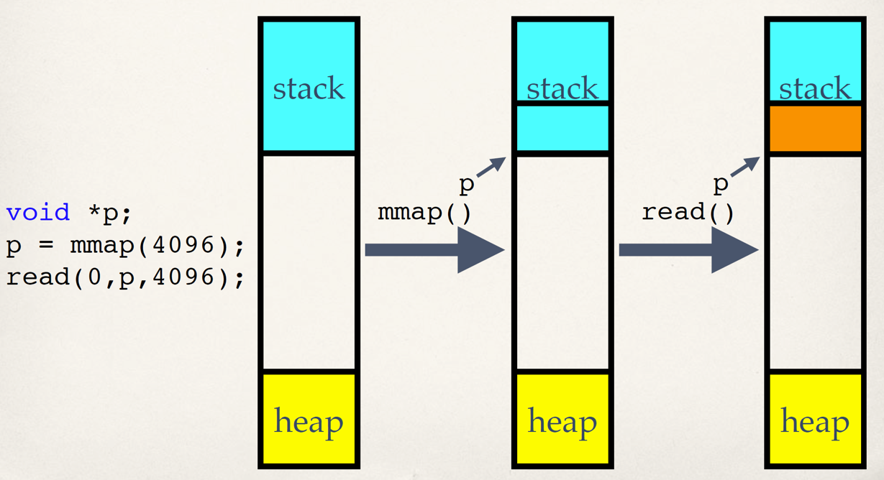
Iago Attack: mmap() (Malicious Behavior)

Slide 31
No Trust to Hypervisor

Slide 32
Untrusted Hypervisor
Control VM
Tools
Guest
VM
Kernel
VMM
Trusted Computing Base
The TCB contains virtualization stack
The TCB size is larger than 9 Million LOCs

Slide 33
Untrusted Hypervisor
One point of penetration leads to full compromise
The virtualization stack should not be trusted
Notes:
Unfortunately, it does grow. Here we show the number of security issues of Xen and Vmware ESX from CVE.
We can see that the number is growing year by year.
In 2012, there’re 39 new security issues found in Xen.
Since in virtualization stack, “one point of …”, we claim that “the virtualization stack …”

Slide 34
Goal of CloudVisor
Defend again curious or malicious cloud operators
To ensure privacy and integrity of a user VM
Be transparent to existing cloud infrastructure
No or little modifications to virtualization stack (OS, Hypervisor)
Minimized TCB
Easy to verify correctness (e.g., formal verification)
Non-goals
DOS, Side-channel attacks, Semantic attacks to VM services from network
Notes:
Awaring of these problems, the goal of cloudvisor is to ...

Slide 35
Virtualization Preliminary: VT-x
VM
Ring 3
Ring 0
guest mode
VM entry
VM exit
host mode
Hypervisor
Notes:
Besides traditional privilege rings on the processor, VT-x introduced a new host mode.
Hypervisor is designed to run in host mode. All privileged operations in guest mode would cause trap into host mode, ie, Vmexit.

Slide 36
Interposition with CloudVisor
VM
Ring 3
Hypervisor
Ring 0
guest mode
VM entry
VM exit
VM entry
VM exit
host mode
Cloudvisor
Notes:
Cloudvisor interposes hypervisor and vms...
In this way, some sensitive states (general purposed registers) could be saved during VMExit.

Slide 37
VM Memory Isolation
Goal: forbid hypervisor access to VM memory
Rules:
When a page is assigned to a VM, CloudVisor changes the ownership of the page
A memory page is only accessible to its owner
Notes:
By leveraging this privileged position, cloudvisor conducts memory isolation by hardware assistance.
The goal of memory isolation is to forbid ...
Cloudvisor also provide strong memory isolation among the hypervisor and guest vms.

Slide 38
Architecture (logically) of CloudVisor

Slide 39
Remote Attestation
VMM
SENTER
SINIT
CloudVisor
initialization
CloudVisor
OK, it’s my CloudVisor
Boot procedure Hash
TPM
Root of Trust

Slide 40
Intel SGX: No Trust To Any System Software

Slide 41
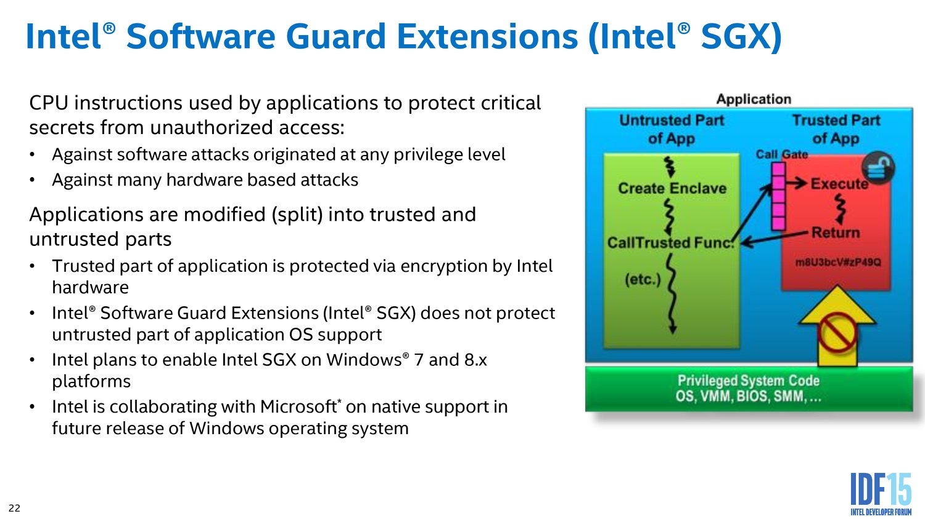

Slide 42
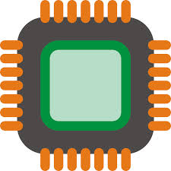

SGX : Isolated Execution
System Memory
CPU Package
Enclave
Access from
OS/VMM
Memory
Encryption
Engine (MEE)
Encrypted
code/data
Snooping
Application keeps its data/code inside the “enclave”
Smallest attack surface by reducing TCB (App + processor)
Protect app’s secret from untrusted privilege software (e.g., OS, VMM)
Notes:
SGX allows part of application code to run in isolation inside an enclave. The enclave region of the main memory is encrypted. The content is only decrypted inside the CPU package using processor specific keys. Thus, even if a malicious adversary has full control over the hardware, it cannot access/modify the enclave. Also, the enclave is protected from other software running in the host, including the OS and hypervisor. In summary, the TCB is the CPU package and the application code running inside and enclave.

Slide 43




SGX : Remote Attestation
Remote platform
Host platform
Hash
1. Request
2. Calculate
MAC
Target Enclave
Challenger Enclave
CMAC
3. Send MAC
SGX CPU
SGX CPU
Quoting Enclave
4. Verify
6. Send signature
5. Sign with group key [EPID]
Attest an application on remote platform
Check the identity of enclave (hash of code/data pages)
Can establish a “secure channel” between enclaves
Notes:
SGX also support remote attestation. So an enclave program running on a host makes a remote attestation request. The remote platform creates a hash of the enclave or measurement. Then it passes this info to a specially purposed enclave who signs this with a group key. As part of the remote attestation, one can also exchange information, this is often used for Diffie-Hellman key exchange to bootstrap a secure channel between two enclaves.

Slide 44
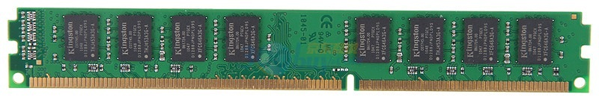
Data Privacy: AISE ^{[Rogers, Micro’07]}
Address
Data Cache
Counter Cache
Data (PlainText)
Counter
Encrypt
XOR
PAD
VM-Key
Secure Processor
Data (CypherText)
Counters
Notes:
AISE is short for address independent seed encryption. It is a technology for data encryption. The main idea is that instead of encrypt/decrypt the data directly, the processor encrypt counters into pad, and then XOR the pad with data for encryption and decryption. Meanwhile, there is a dedicated cache on-chip for the counters to improvement the performance.

Slide 45
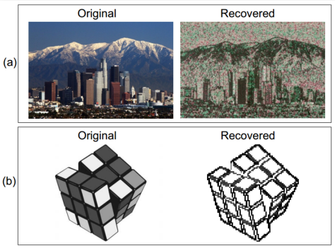
SGX’s Vulnerabilities
Side channel attack
Malicious OS still controls page fault handler
If know the photo processing algorithm, can get the image by monitoring page fault
Not 100% accurate, but still good enough

Slide 46
Review

Slide 47
OSI, TCP/IP & Protocol Stack
7th Application Layer
Application Layer
HTTP
SMTP
POP3
FTP
…
End-to-end Layer
6th Presentation Layer
5th Session Layer
4th Transport Layer
Transport Layer
TCP
UDP
3th Network Layer
Network Layer
IP
Network Layer
ICMP
2nd Link Layer
Link Layer
ARP & RARP
Ethernet
PPP
…
Link Layer
1st Physical Layer
OSI
TCP/IP
CSE

Slide 48
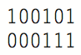
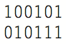
Coding: Incremental Redundancy
Forward error correction
Perform coding before storing or transmitting
Later decode the data without appealing to the creator
Hamming distance
Number of 1 in A ⊕ B , ⊕ is exclusive OR (XOR)
If H-distance between every legitimate pair is 2
000101, can only detect 1-bit flip
If H-distance between every legitimate pair is 3
Can only correct 1 bit flip
If H-distance between every legitimate pair is 4
Can detect 2-bit flip, correct 1-bit flip

Slide 49
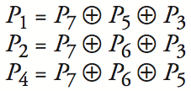
Hamming(7,4): 4-bit -> 7-bit Encoding
Not Match | Error
None | None
P1 | P1
P2 | P2
P4 | P4
P1 & P2 | P3
P1 & P4 | P5
P2 & P4 | P6
P1 & P2 & P4 | P7
4 bits -> 7 bits (56 using only extra 7)
3 extra bits to distinguish 8 cases
e.g. 1101 -> 1010101
Correct 1-bit errors
1010101 -> 1010001 : P1 & P4 not match
1010101 -> 1110101 : P2 not match
1 2 3 4 5 6 7
1
0
1
0
1
0
1
1
0
1
0
1
0
1
1
0
1
0
1
0
1

Slide 50
Best-effort Network
Best-effort network
If it cannot dispatch, may discard a packet
Guaranteed-delivery network
Also called store-and-forward network, no discarding data
Work with complete messages rather than packets
Uses disk for buffering to handle peaks
Tracks individual message to make sure none are lost
In real world
No absolute guarantee
Guaranteed-delivery: higher layer; best-effort: lower layer

Slide 51
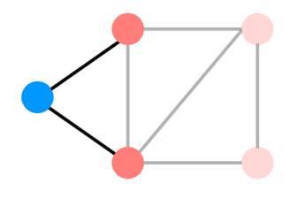
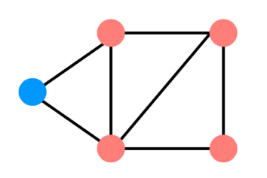
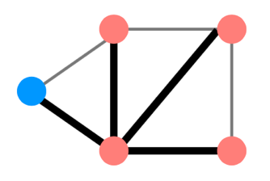
Distributed Routing: 3 Steps in General
Nodes learn about their neighbors via the HELLO protocol
Nodes learn about other reachable nodes via advertisements
Nodes determine the minimum-cost routes (of the routes they know about)

Slide 52
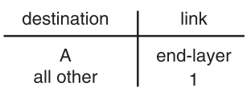
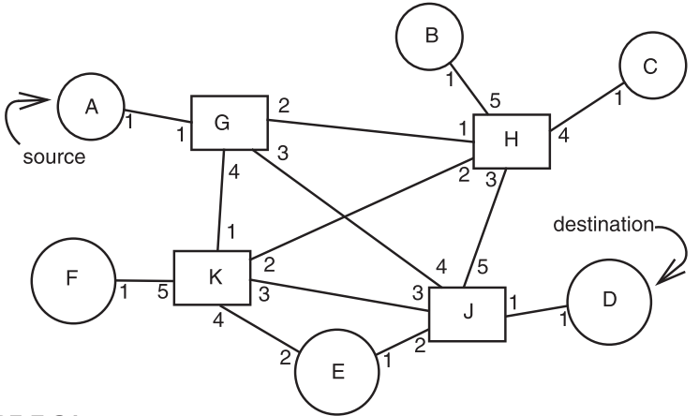
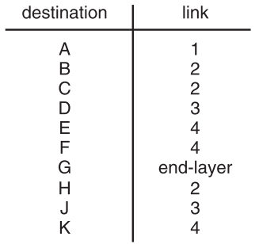
Path Vector Exchange
A
G
Need coordination to ensure no loop

Slide 53
Assurance of End-to-end Protocol
Assurance of at-least-once delivery
Assurance of at-most-once delivery
Assurance of data integrity
Assurance of stream order & closing of connections
Assurance of jitter control
Assurance of authenticity and privacy
Assurance of end-to-end performance

Slide 54
Fixed Timer is Evil
Fixed timers lead to congestion collapse in NFS
Emergent phase synchronization of periodic protocols
Wisconsin time server meltdown

Slide 55
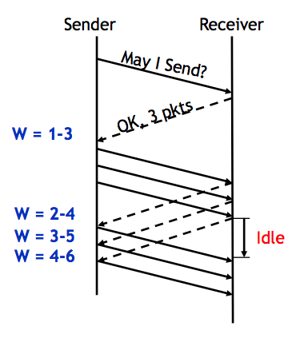
Sliding Window
Sender advances the window by 1 for each in-sequence ACK it receives
- Reduces idle periods
- Pipelining idea
But what’s the correct value for the window?
- We’ll revisit this question
- First, we need to understand windows

Slide 56
Sliding Window Size
window size ≥ round-trip time × bottleneck data rate
Sliding window with one segment in size
Data rate is window size / RTT
Enlarge window size to bottleneck data rate
Data rate is window size / RTT
Enlarge window size further
Data rate is still bottleneck
Larger window makes no sense
- Receive 500 KBps
- Sender 1 MBps
- RTT 70ms
- A segment carries 0.5 KB
- Sliding window size = 35KB (70 segment)

Slide 57
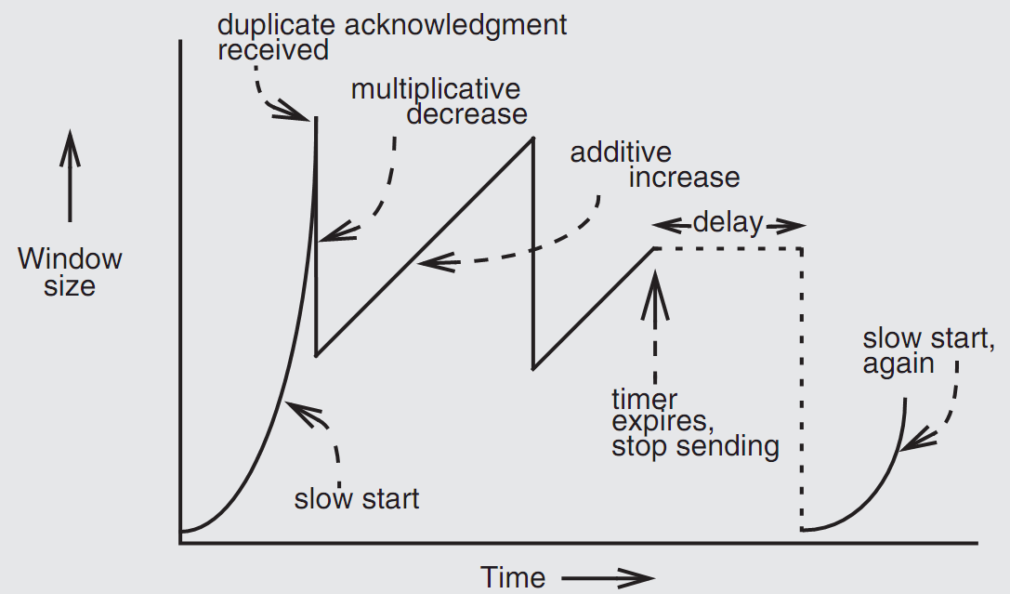
Retrofitting TCP
Notes:
Since TCP does not know whether a duplicate ACK is caused by a lost segment or just a reordering of segments, it waits for a small number of duplicate ACKs to be received.

Slide 58
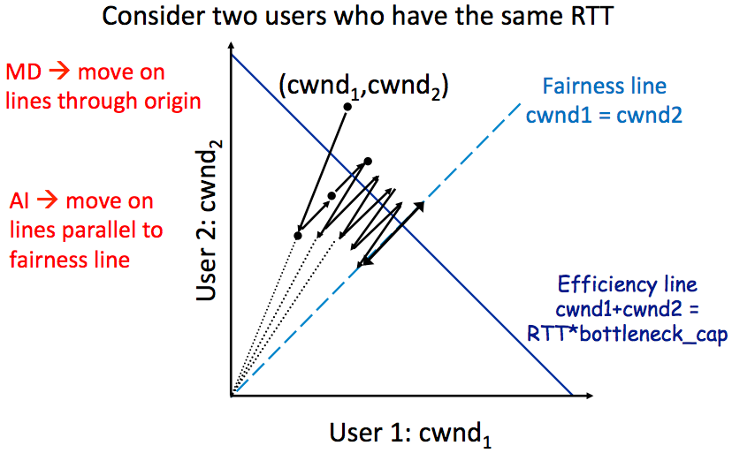
AIMD Leads to Efficiency and Fairness
Notes:
AIMD: addition increase, multiple decrease.

Slide 59
Summary of Congestion Control
Reliability Using Sliding Window
- Tx Rate = W / RTT
Congestion Control
- W = min(Receiver_buffer, cwnd)
- cwnd is adapted by the congestion control protocol to ensure efficiency and fairness
- TCP congestion control uses AIMD which provides fairness and efficiency in a distributed way

Slide 60
Review: Fault Tolerant

Slide 61
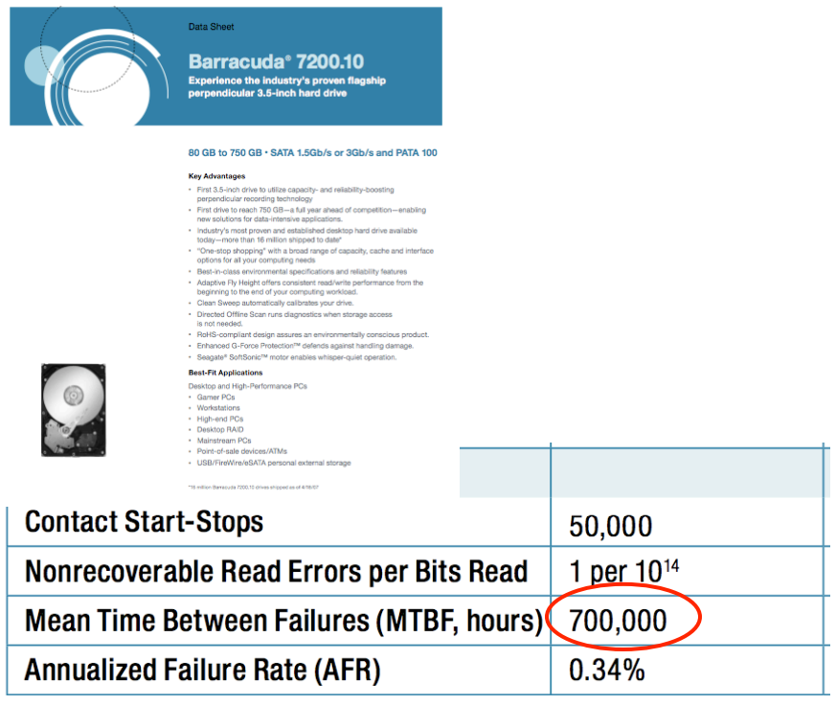
MTBF
Web page snapshot

Slide 62
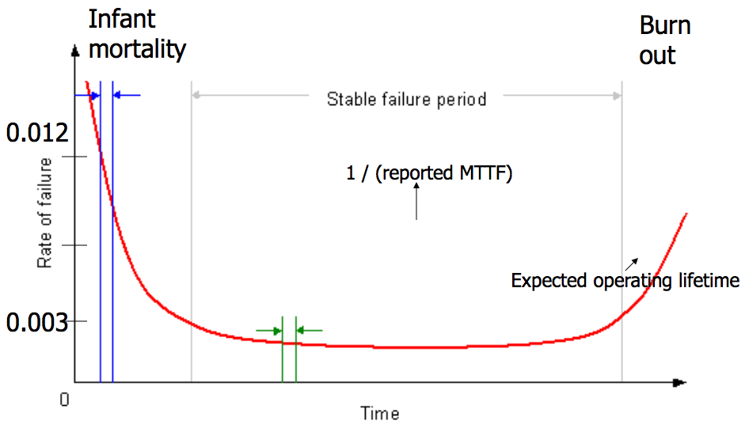
The Bathtub Curve

Slide 63
Availability in Practice
Carrier airlines (2002 FAA fact book)
99.9993% availability, 41 accidents, 6.7M departures
911 Phone service (1993 NRIC report)
99.994%, 29 minutes per line per year
Standard phone service (various sources)
99.99+%, 53+ minutes per line per year
End-to-end Internet Availability
95% - 99.6%

Slide 64
Systematically Applying Redundancy
Masking error
Analog system designer: margin
Digital system designer: redundancy
Outline
Coding: incremental redundancy
Replication: massive redundancy
Voting
Repair

Slide 65
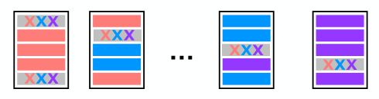
RAID 5 (Spread Out the Parity)
+ can recover from single-disk failure
+ requires N+1 disks (not 2N)
+ performance benefits if stripe a single file across multiple data disks
+ writes are spread across disks

Slide 66
Review: Transaction

Slide 67
Goal: Build Reliable Systems from Unreliable Components
The abstraction that makes that easier is transactions, which provide atomicity and isolation, while not hindering performance
Shadow copies (simple, poor performance) ,
or logs (better performance, a bit more complex)
atomicity
2PL (Two-phase locking) ,
or OCC (Optimistic Concurrency Control)
isolation
eventually, we also want transaction-based systems to be distributed: to run across multiple machines

Slide 68
Shadow Copy
Write to a copy of data, atomically switch to new copy
Switching can be done with one all-or-nothing operation (sector write)
Requires a small amount of all-or-nothing atomicity from lower layer (disk)
Main rule: only make one write to current/live copy of data
In our example, sector write for rename
Creates a well-defined commit point

Slide 69
A Log Sample
+-------+------+--------+-------+------+--------+-------+
TID | T1 | T1 | T1 | T2 | T2 | T2 | T3 |
OLD | A=0 | B=0 | | A=100 | B=50 | | A=80 |
NEW | A=100 | B=50 | COMMIT | A=80 | B=70 | COMMIT | A=110 |
+-------+------+--------+-------+------+--------+-------+
begin
A = 100
B = 50
commit
begin
A = A - 20
B = B + 20
commit
begin
A = A + 30
--CRASH--
Begin
Write variable
Read variable
Commit
Abort

Slide 70
Read
+-------+------+--------+-------+------+--------+-------+
TID | T1 | T1 | T1 | T2 | T2 | T2 | T3 |
OLD | A=0 | B=0 | | A=100 | B=50 | | A=80 |
NEW | A=100 | B=50 | COMMIT | A=80 | B=70 | COMMIT | A=110 |
+-------+------+--------+-------+------+--------+-------+
read(log, var):
commits = {}
// scan backwards
for record r in log[len(log) - 1] .. log[0]:
// keep track of commits
if r.type == commit:
commits.add(r.tid)
// find var’s last committed value
if r.type == update and
（r.tid in commits or r.tid == current_tid) and
r.var == var:
return r.new_value
Notes:
Q: Which is a commit point?
Assumption: writing a single disk block is atomic. A partially written record is ignored.

Slide 71
Performance Problem of Log-only Approach
Write performance is probably good
Sequential writes, instead of random
Need to write to disk twice instead of once
Read performance is terrible!
Scan the log for every read!
Recovery is instantaneous
Nothing to do

Slide 72
Performance Optimization
Keep both a log and cell storage
Log as before: authoritative, provides all-or-nothing atomicity
Cell storage: provides fast reads, but cannot provide all-or-nothing
Both are stored on disk
Terminology
"log" an update when it's written to the log
"install" an update when it's written to cell storage
Notes:
[ board: log, cell storage; updates going to both, read from cell storage ]

Slide 73
Read / write with Cell Storage
+-------+------+--------+-------+------+--------+-------+
TID | T1 | T1 | T1 | T2 | T2 | T2 | T3 |
OLD | A=0 | B=0 | | A=100 | B=50 | | A=80 |
NEW | A=100 | B=50 | COMMIT | A=80 | B=70 | COMMIT | A=110 |
+-------+------+--------+-------+------+--------+-------+
Cell Storage
A 110
B 70
read(var):
return cell_read(var)
write(var, value):
log.append(cur_tid, update,
var, read(var), value)
cell_write(var, value)
Notes:
Recovery? Crash between logging and installing.
Write is not all-or-nothing! install value before commit? what if crash? Need to roll back to old value (which is saved in the log)
Log still contains the same things.
As we're running, maintain cell storage for A and B.
Except one problem: after crash, A's value in cell storage is wrong.
Last action aborted (due to crash), but its changes to A are visible.
We're going to have to repair this in our recovery function.
Good thing we have the log to provide authoritative information.

Slide 74
Recovery with Cell Storage
+-------+------+--------+-------+------+--------+-------+
TID | T1 | T1 | T1 | T2 | T2 | T2 | T3 |
OLD | A=0 | B=0 | | A=100 | B=50 | | A=80 |
NEW | A=100 | B=50 | COMMIT | A=80 | B=70 | COMMIT | A=110 |
+-------+------+--------+-------+------+--------+-------+
Cell Storage
A 110
B 70
commits = {}
recover(log):
commits = {}
for record r in log[len(log)-1] .. log[0]:
if r.type == commit:
commits.add(r.tid)
if r.type == update and r.tid not in commits:
cell_write(r.var, r.old_val) // undo
Notes:
Recovery? Crash between logging and installing.
Write is not all-or-nothing! install value before commit? what if crash? Need to roll back to old value (which is saved in the log)
Log still contains the same things.
As we're running, maintain cell storage for A and B.
Except one problem: after crash, A's value in cell storage is wrong.
Last action aborted (due to crash), but its changes to A are visible.
We're going to have to repair this in our recovery function.
Good thing we have the log to provide authoritative information.

Slide 75
Performance Now
Writes might still be OK
but we do write twice: log & install
Reads are fast
just look up in cell storage
Recovery requires scanning the entire log
Remaining performance problems:
We have to write to disk twice
Scanning the log will take longer and longer, as the log grows

Slide 76
Optimization 1: Improve Writes
Storing installing in a (volatile) cache, e.g., memory
Writes can now be fast: just one write, instead of two
Hope that variable is modified several times in cache before flush
Reads can also be benefited
Reads go through the cache, since cache may contain more up-to-date values

Slide 77
Read & Write with Cache
+-------+------+--------+-------+------+--------+-------+
TID | T1 | T1 | T1 | T2 | T2 | T2 | T3 |
OLD | A=0 | B=0 | | A=100 | B=50 | | A=80 |
NEW | A=100 | B=50 | COMMIT | A=80 | B=70 | COMMIT | A=110 |
+-------+------+--------+-------+------+--------+-------+
Cell Storage
A 110
B 70
Cache
A 110
B 70
read(var):
if var in cache:
return cache[var]
else: // may evict others from cache to cell storage
cache[var] = cell_read(var)
return cache[var]
write(var, value):
log.append(current_tid, update, var, read(var), value)
cache[var] = value

Slide 78
Problem Brought by Cache
Atomicity problem: cell storage (on disk) may be out-of-date
Is it possible to have changes that should be in cell storage, but aren't?
Yes: might not have flushed the latest commits
Is it possible to have changes that shouldn't be in cell storage, but are?
Yes: flushed some changes that then aborted (same as before)
Solution: change the recover procedure
Need a redo phase in addition to an undo phase in recovery
Don't treat actions with an abort record as "done”
There might be leftover changes from them in cell storage

Slide 79
Recover with Cache
+-------+------+--------+-------+------+--------+-------+
TID | T1 | T1 | T1 | T2 | T2 | T2 | T3 |
OLD | A=0 | B=0 | | A=100 | B=50 | | A=80 |
NEW | A=100 | B=50 | COMMIT | A=80 | B=70 | COMMIT | A=110 |
+-------+------+--------+-------+------+--------+-------+
Cell Storage
A 110
B 70
Cache
A 110
B 70
recover(log):
commits = {}
for record r in log[len(log)-1] .. log[0]:
if r.type == commit:
commits.add(r.tid)
if r.type == update and r.tid not in commits:
cell_write(r.var, r.old_val) // undo
for record r in log[0] .. log[len(log)-1]:
if r.type == update and r.tid in commits:
cell_write(r.var, r.new_value) // redo

Slide 80
Optimization 2: Truncate the Log
Current log grows without bound: not practical
What part of the log can be discarded?
Must know the outcome of every action in that part of log
Cell storage must reflect all of those log records (commits, aborts).
Truncating mechanism (assuming no pending actions):
Flush all cached updates to cell storage
Write a checkpoint record, to save our place in the log
Truncate log prior to checkpoint record
(Often log implemented as a series of files, so can delete old log files)
With pending actions, delete before checkpoint & earliest undecided record

Slide 81
Checkpointing
Doing the following:
1. Stop accepting new transactions
2. Wait until all current transactions commit or abort and have written the COMMIT or ABORT to the log
3. Flush the log to disk
4. Write a log record <CKPT> and flush the log again
5. Resume accepting transactions
No need to look in the log file prior to the last checkpoint

Slide 82
Non-quiescent Checkpointing
The problem with checkpointing:
Need to stop the system until all current operations have committed or aborted
Non-quiescent checkpointing:
1. Write a record <START CKPT(T1…Tk)> and flush log (T1,…Tk are the active transactions)
2. Wait until all of T1, … Tk commit or abort, but allow new transactions to start
3. When all of T1,…Tk have written COMMIT or ABORT, then write <END CKPT> to the log

Slide 83
Optimization-3: External Synchronous I/O
Problem: flush to disk is slow
Lazy writing, even for the log file
Some app, e.g., database, calls sync() to ensure flushing
But sync() is slow…
Solution: External Sync
Once the kernel return from sync(), the file may not be flushed
It will be flushed if something externally visible happens
E.g., print to the user, network sending, serial port outcome, etc.
Rethink the Sync, OSDI 2004

Slide 84

Serialization
Goal: run transactions T1, T2, .., TN concurrently, and have it “appear” as if they ran sequentially
What does this mean?
T1
begin
read(x)
tmp = read(y)
write(y, tmp+10)
commit
T2
begin
write(x, 20)
write(y, 30)
commit

Slide 85
Conflict Serializability
Two operations conflict if :
they operate on the same object, and
at least one of them is write
the actions belong to different transactions
Conflict serializability
A schedule is conflict serializable if the order of its conflicts (the order in which the conflicting operations occur) is the same as the order of conflicts in some sequential schedule

Slide 86
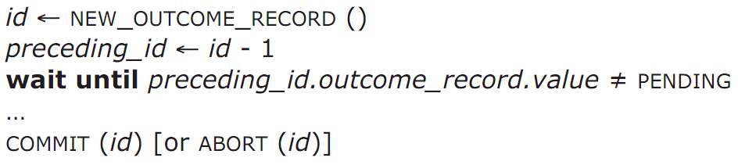
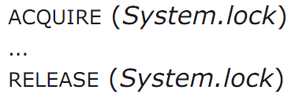
Global Lock: System-wide Locking
System-wide lock
begin_transaction ACQUIRE (System.lock) …
… RELEASE (System.lock) end_transaction
Allow only one transaction to run at a time
Serialize potentially concurrent transactions in the order that they call ACQUIRE

Slide 87
Simple Locking
Simple locking
1. Acquire a lock for every shared data in advance
2. Release locks only after commit or abort
Lock point
Lock set: locks acquired when reaches lock point
Lock manager’s enforcement
Intercept read/write/commit/abort, and check
Problems
How to enumerate all shared object to access?
The set of might access may be larger than does access

Slide 88
Two-phase Locking
Two-phase
Each shared variable has a lock (fine-grained locking)
Before any operation on the variable, the transaction must acquire the corresponding lock
After transaction releases a lock, it cannot acquire any other locks
Features
Avoids to know the lock set in advance
Acquire locks as it proceeds, access data as soon as it acquires the lock

Slide 89
OCC Executes a Transaction in Three Phases
Phase 1: Concurrent local processing
Reads tuples into a read set
Buffers writes into a write set
Phase 2: Validation in critical section
Validates whether serializability is guaranteed:
Has any tuple in the read set been modified?
Phase 3: Commit the results in critical section or abort
Aborts: aborts the transaction if validation fails
Commits: installs the write set and commits the transaction

Slide 90
Two-phase Commit
Phase-1: preparation / voting
Lower-layer transactions either aborts or tentatively committed
Higher-layer transaction evaluate lower situation
Phase-2: commitment
If top-layer, then COMMIT or ABORT
If nested itself, then become tentatively committed

Slide 91
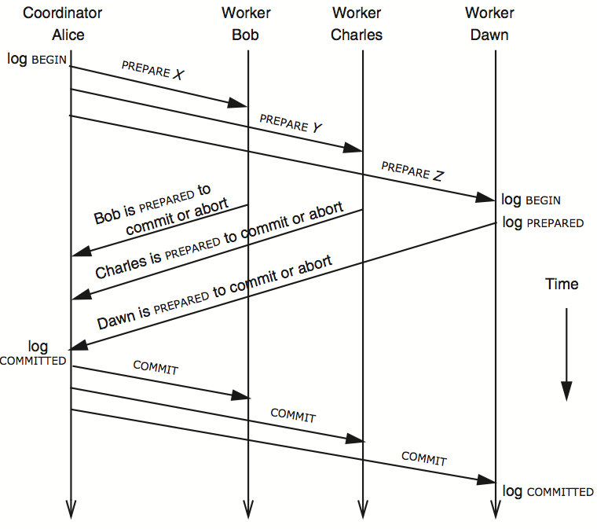
3N messages

Slide 92
Review: Consistency

Slide 93
Strict Consistency
Definition
“The result of a READ of a named object is always the value that was provided by the most recent WRITE to that object”
Hides the constraint violation behind modular boundaries
Actions outside the transaction performing the update will never see data that is inconsistent with the invariant
Depends on actions honoring abstractions
E.g. by using only the intended reading and writing operations
Cache specification
Does not demand that the replica in the cache always be identical the backing store
Requires only that the cache deliver data at its interface that meets the specification

Slide 94
Eventual Consistency
Inconsistency window
After a data update the constraint may not hold until some unspecified time in the future
An observer may, using the standard interfaces, discover that the invariant is violated
Different observers may even see different results
Once updates stop occurring, it will make a best effort drive toward the invariant

Slide 95
Quorum
Define separate read &write quorums: Q_{r} & Q_{u}
Q_{r} + Q_{u} > N_{replicas} (Why?)
Confirm a write after writing to at least Q_{u} of replicas
Read at least Q_{r} agree on the data or witness value
Example
In favor of reading: N_{replicas} = 5, Q_{w} = 4, Q_{r} = 2
In favor or updating: N_{replicas} = 5, Q_{w} = 2, Q_{r} = 4
Enhance availability by Q_{w} = N_{replicas} & Q_{r} = 1

Slide 96
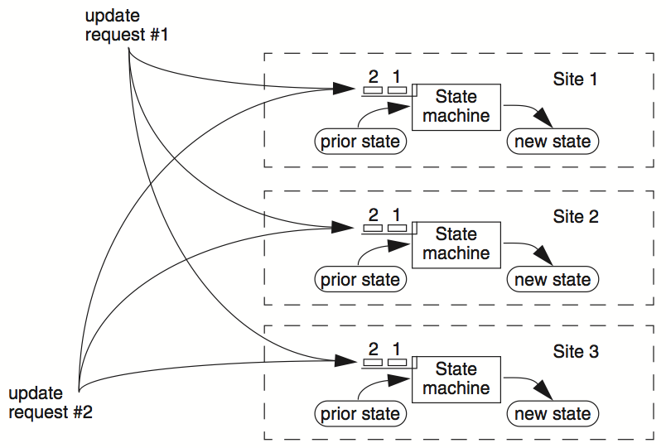

Slide 97
Primary/Backup Model
Primary does important stuff
Ensures that it sends all updates to the backup before ACKing the coordinator
Chooses an ordering for all operations, so that the primary and backup agree
Decides all non-deterministic values (e.g., random(), time())

Slide 98

View Server
Network partition
rejected by S₁
(Cannot get ACK from S₂)
(dead)
S₁
S₁
C
VS
1: S₁, S₂
2: S₂, --
S₂
(primary)

Slide 99
View Server
To discover failures
Replicas ping to the view server
If view server misses N pings in a row, it deems a server to be dead
Basic failure (actual worker crash):
1. Primary fails; pings cease
2. View server lets S2 know it‘s primary, and it handles any client requests
Before S2 knowing it’s the primary, it will simply reject requests that come directly from coordinators
3. View server will eventually recruit a new idle server to act as backup

Slide 100
Political Science 101
Paxos has rounds; each round has a unique ID (N)
Rounds are asynchronous
Time synchronization not required
If you’re in round j and hear a message from round j+1, abort everything and move over to round j+1
Use timeouts; may be pessimistic
Each round itself broken into phases
Phases are also asynchronous

Slide 101
Paxos in Action: Phase 0
Client sends a request to a proposer
Proposer
request
Acceptor
Client
Network
Acceptor
Acceptor
quorum
Learner

Slide 102
Paxos in Action: Phase 1a (Prepare)
Leader creates a proposal N and send to quorum
N is greater than any previous proposal number seen by this proposer
Leader
proposal N
Acceptor
Client
Network
Acceptor
Acceptor
quorum
Learner

Slide 103
Paxos in Action: Phase 1b (Prepare)
Acceptor: if proposal ID > any previous proposal
reply with the highest past proposal number and value
promise to ignore all IDs < N
else ignore (proposal is rejected)
Leader
promise N
Acceptor
Client
Network
Acceptor
Acceptor
quorum
Learner

Slide 104
Paxos in Action: Phase 2a (Accept)
Leader: if receive enough promise
set a value V to the proposal. V can be decided value or new value
send accept request to quorum with the chosen value V
Leader
accept request(N, V)
Acceptor
Client
Network
Acceptor
Acceptor
quorum
Learner
Ignore all proposals < N

Slide 105
Paxos in Action: Phase 2b (Accept)
Acceptor: if the promise still holds
register the value V
send accepted message to Proposer/Learners
else ignore the message
Leader
accepted
Acceptor
Client
Network
Acceptor
Acceptor
accepted
quorum
Learner
Learner
Ignore all proposals < N

Slide 106
Paxos in Action: Phase 3 (Learn)
Learner: responds to Client and/or take action on the request
Leader
Acceptor
Client
Network
Acceptor
Acceptor
quorum
Learner
Learner
Ignore all proposals < N

Slide 107
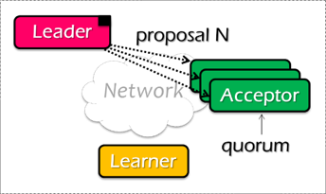
Paxos Pseudo-code
A node decides to be Leader
Leader choose M_{n} > N_{h}
Leader sends <proposal, M_{n} > to all nodes
Acceptor receives <proposal, N>
if N < N_{h}
reply <promise-reject>
else
N_{h} = N
reply <promise-ok, N_{a}, V_{a}>
Ignore all proposals < N_{h}

Slide 108

Paxos Pseudo-code
If Leader gets promise-ok from a majority
If Leader fails to get majority promise-ok
Upon receiving <accept, N, V>
V = non-empty value (highest N_{a} received)
if V = null, then Leader can pick any V
send <accept, M_{n}, V> to all nodes
delay and restart Paxos
if N < N_{h}
reply <accept-reject>
else
N_{a} = N; V_{a} = V; N_{h} = N;
reply <accept-ok>

Slide 109
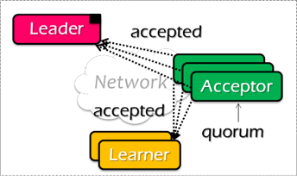
Paxos Pseudo-code
If Leader gets accept-ok from a majority
If Leader fails to get majority accept-ok
send <decide, V_{a}> to all nodes
delay and restart Paxos

Slide 110
Paxos Pseudo-code
N_{a}: highest proposal number accepted
V_{a}: accepted value of N_{a}
N_{h}: highest proposal number seen
M_{n}: my proposal number
N_{a} = V_{a} = null
N_{h} = N0:0
N_{a} = V_{a} = null
N_{h} = N1:0
N_{a} = V_{a} = null
N_{h} = N2:0
M_{n} = N1:1
<proposal, N1:1>
<proposal, N1:1>
N_{h} = N1:1
N_{a} = null
V_{h} = null
N_{h} = N1:1
N_{a} = null
V_{h} = null
<promise, null, null>
<promise, null, null>
<accept, N1:1, V1>
<accept, N1:1, V1>
N_{h} = N1:1
N_{a} = N1:1
V_{h} = V1
N_{h} = N1:1
N_{a} = N1:1
V_{h} = V1
<accept-ok>
<accept-ok>
<decide, V1>
<decide, V1>
Time

Slide 111
Security

Slide 112
Review: Policy & Threat Model
Security is a negative goal
How to make progress in building a secure system?
Be clear about goals: "policy”
Privacy, integrity, availability
Be clear about assumptions: "threat model”
E.g., an attacker knows the password, or the administrators are not trusted

Slide 113
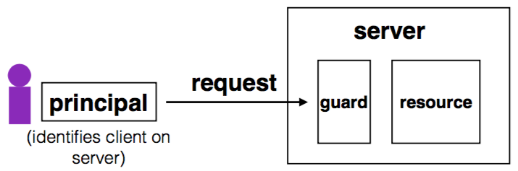
Review: Complete Mediation
Guard typically provides:
Authentication: is the principal who they claim to be?
Authorization: does principal have access to perform request on resource?
A user uses a reference to name the resource
E.g., an fd. That’s why such mechanism is also known as “reference monitor”

Slide 114
Principle of Least Privilege
Deal with bugs / incomplete mediation
Any component that can arbitrarily access a resource must invoke the guard
If component has a bug or design mistake, can lead to incomplete mediation
General plan: reduce the number of components that must invoke the guard
E.g., arrange for DB server to check permissions on records returned, then security does not depend as much on lookup.cgi

Slide 115

Review: Key Problem of Password
Key problem: once you send a password to the server, it can impersonate you
Solved part of the problem by hashing the password database
But still sending the password to the server to verify on login

Slide 116
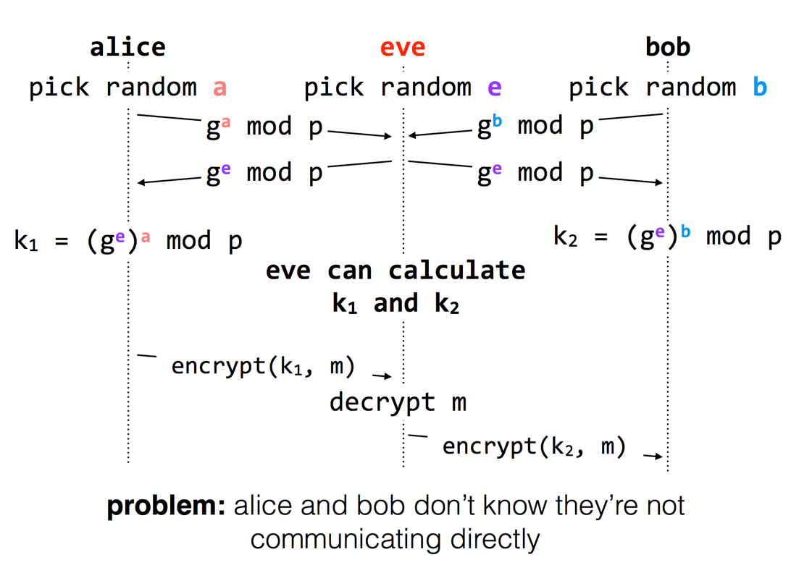
Diffie-Hellman key exchange

Slide 117
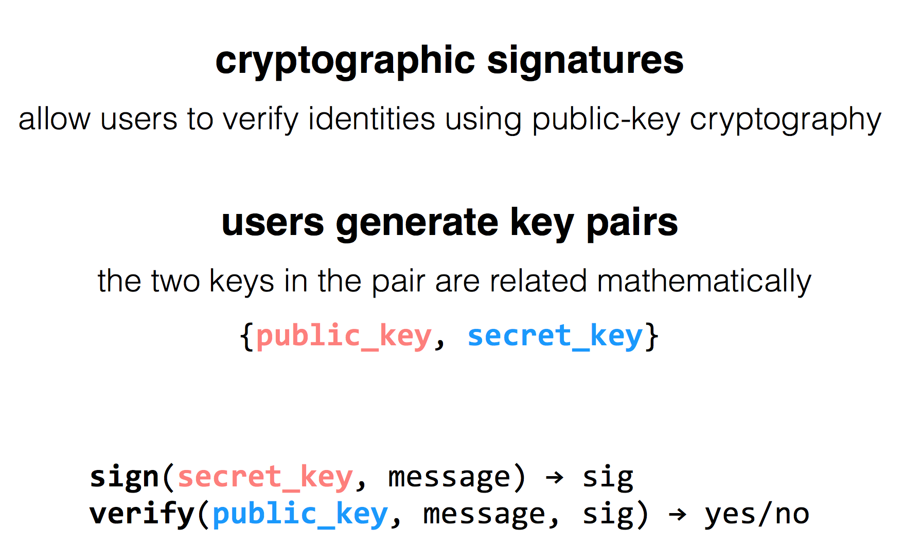
RSA Algorithm

Slide 118
Problem: The Complexity of Computer Systems
Emergent properties (surprise!)
The properties that are not considered at design time
Propagation of effects
Small change -> big effect
Incommensurate scaling
Design for small model may not scale
Trade-offs
Waterbed effect

